Slide 1
15-213 Recitation: Attack Lab
18th Feb 2019

Slide 2
Agenda
Reminders
Stacks
Attack Lab Activities

Slide 3
Reminders
Attack lab is due (21st Feb, 2019) !
“But if you wait until the last minute, it only takes a minute!” – NOT!
Don’t waste your grace days on this assignment!

Slide 4
Attack Lab
We’re letting you hijack programs by running buffer overflow attacks on them.
Is that not justification enough?
To understand stack discipline and stack frames
To defeat relatively secure programs with return oriented programming

Slide 5
Attack Lab Activities
Three activities
Each relies on a specially crafted assembly sequence to purposefully overwrite the stack
Activity 1 – Overwrites the return addresses
Activity 2 – Writes an assembly sequence onto the stack
Activity 3 – Uses byte sequences in libc as the instructions

Slide 6
Attack Lab Activities
One student needs a laptop
Login to a shark machine
$ wget http://www.cs.cmu.edu/~213/activities/rec5.tar
$ tar xvf rec5.tar
$ cd rec5
$ make
$ gdb act1

Slide 7
Activity 1
(gdb) break clobber
(gdb) run
(gdb) x $rsp
(gdb) backtrace
Q. Does the value at the top of the stack match any frame?

Slide 8
Activity 1 Continued
(gdb) x /2gx $rdi // Here are the two key values
(gdb) stepi // Keep doing this until
(gdb)
clobber () at support.s:16
16 ret
(gdb) x $rsp
Q. Has the return address changed?
(gdb) finish // Should exit and print out “Hi!”

Slide 9
Activity 1 Post
Clobber overwrites part of the stack with memory at $rdi, including the all-important return address
In act1 it writes two new return addresses:
0x400500: address of printHi()
0x400560: address in main
Call clobber()
Clobber executes
In printHi()
In main()
0x7fffffffe338
0x000000400553
0x000000400560
0x000000400500
ret
ret
0x000000400560

Slide 10
Activity 2
$gdb act2
(gdb) break clobber
(gdb) run
(gdb) x $rsp
Q. What is the address of the stack and the return address?
(gdb) x /4gx $rdi
Q. What will the new return address be? (i.e., what is the first value?)

Slide 11
Activitity 2 Continued
(gdb) x/5i $rdi + 8 // Display as instructions
Q. Why rdi + 8?
Q. What are the three addresses?
(gdb) break puts
(gdb) break exit
Q. Do these addresses look familiar?

Slide 12
Activity 2 Post
Normally programs cannot execute instructions on the stack
Main used mprotect to disable the memory protection for this activity
Clobber wrote an address that’s on the stack as a return address
Followed by a sequence of instructions
Three addresses show up in the exploit:
0x48644d → “Hi\n” string
0x4022e0 → puts() function
0x4011a0 → exit() function

Slide 13
Activity 3
$gdb act3
(gdb) break clobber
(gdb) run
(gdb) x /5gx $rdi
Q. Which value will be first on the stack?
Q. At the end of clobber, where will the function return to?

Slide 14
Activity 3 Continued
(gdb) x /2i <return address>
Q. What does this sequence do?
Q. Do the same for the other addresses. Note that some are return addresses and some are for data. When you continue, what will the code now do?

Slide 15
Activity 3 Post
It’s harder to stop programs from running existing pieces of code in the executable.
Clobber wrote multiple return addresses (aka gadgets) that each performed a small task, along with data that will get popped off the stack while running the gadgets.
0x457d0c: pop %rdi; retq
0x47fa64: Pointer to the string “Hi\n”
0x429a6a: pop %rax; retq
0x400500: Address of a printing function
0x47f001: callq *%rax

Slide 16
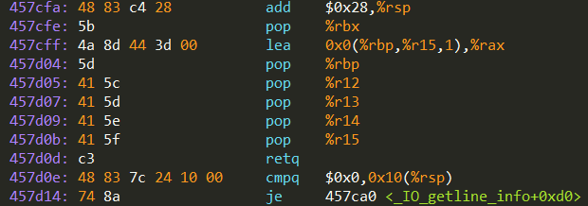

Activity 3 Post
Note that some of the return addresses actually cut off bytes from existing instructions
0x457d0b …0c …0d
-----------------------------------------
pop %r15 retq
41 5f c3
pop %rdi retq
5f c3

Slide 17
Attack Lab Tools
gcc –c test.s; objdump –d test.o > test.asm
Compiles the assembly code in test.s and shows the actual bytes for the instructions
./hex2raw < exploit.txt > converted.txt
Convert hex codes in exploit.txt into raw ASCII strings to pass to targets
See the writeup for more details on how to use this
(gdb) display /12gx $rsp (gdb) display /2i $rip
Displays 12 elements on the stack and the next 2 instructions to run
GDB is also useful to for tracing to see if an exploit is working

Slide 18
If you get stuck
Please read the writeup. Please read the writeup. Please read the writeup. Please read the writeup!
CS:APP Chapter 3
View lecture notes and course FAQ at http://www.cs.cmu.edu/~213
Office hours Sunday through Saturday 5:00-9:00pm in WH 5207
Post a private question on Piazza
man gdb, gdb's help command

Slide 19
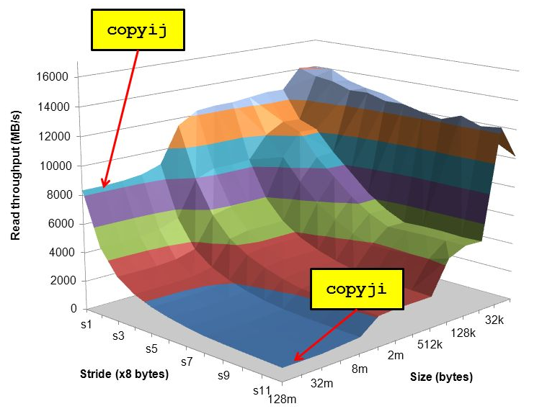
Cache Lab Overview
Programs exhibiting locality run a lot faster!
Temporal Locality – same item referenced again
Spatial Locality – nearby items referenced again
Cache Lab’s Goal:
Understand how L1, L2, … etc. caches work
Optimize memory dependent code to minimize cache misses and evictions
Noticeable increase in speed
The use of git is required (affects your style grade)
Commit regularly with meaningful commit messages

Slide 20
If you get stuck…
Reread the writeup
Look at CS:APP Chapter 6
Review lecture notes (http://cs.cmu.edu/~213)
Come to Office Hours (Sunday to Thursday, 5-9pm WH-5207)
Post private question on Piazza
man malloc, man valgrind, man gdb

Slide 21
Cache Lab Tips!
Review cache and memory lectures
Ask if you don’t understand something
Start early, this can be a challenging lab!
Don’t get discouraged!
If you try something that doesn't work, take a well deserved break, and then try again
Finally, Good luck on Cache Lab!

Slide 22
Appendix
Valgrind
Clang / LLVM
Cache Structure

Slide 23
Appendix: Valgrind
Tool used for debugging memory use
Finds many potential memory leaks and double frees
Shows heap usage over time
Detects invalid memory reads and writes
To learn more… man valgrind
Finding memory leaks
$ valgrind –leak-resolution=high –leak-check=full –show-reachable=yes –track-fds=yes ./myProgram arg1 arg2

Slide 24
Appendix: Clang / LLVM
Clang is a (gcc equivalent) C compiler
Support for code analyses and transformation
Compiler will check you variable usage and declarations
Compiler will create code recording all memory accesses to a file
Useful for Cache Lab Part B (Matrix Transpose)

Slide 25
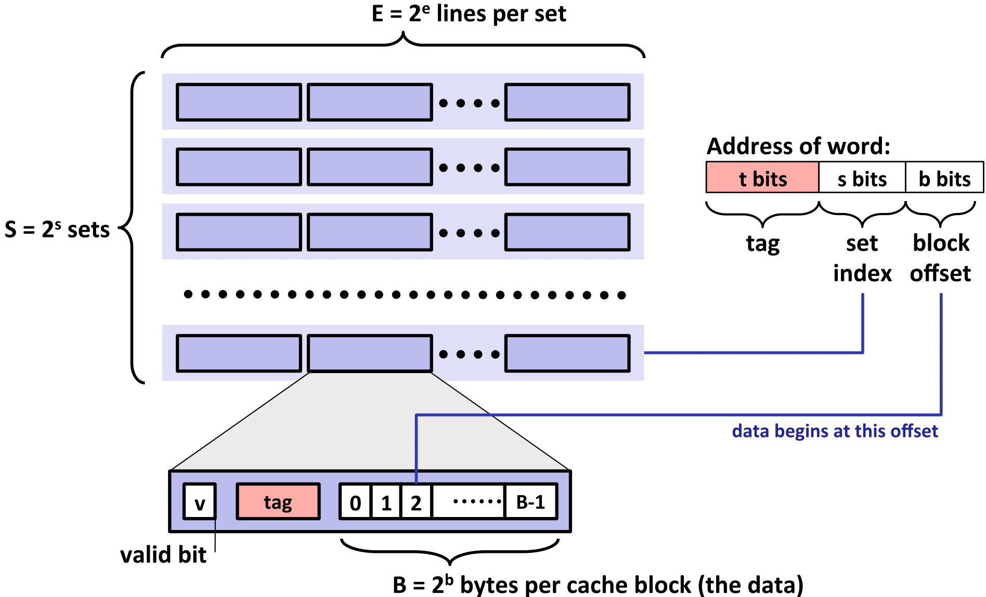
Appendix: Cache Structure

